Slide 1
DAY 1 / WELCOME
WELCOME
Day 1 | Azure components, one at a time
Today's promise
Our working rule
• Understand the service before connecting it to an app.
• See the same resource in the portal and VS Code.
• Leave with repeatable, evidence-based exercises.
• Explain -> portal -> VS Code -> verify -> practise.
• Use existing, approved training resources.
• Fictional data only; no secrets on screen.
REFERENCE / Start Here: Phase A
Student route
LBS | Azure developer training | V3 | Fictional data only
01

Slide 2
DAY 1 / LEARNING PATH
CONCEPT
Two days: understand first, integrate later
Day 1 | fundamentals
Day 2 | messaging and Azure AI
• Orientation and Azure access
• SQL and Blob Storage
• HTTP Function, Logs and basic KQL
• Service Bus and the Azure tracker demo
• Azure AI services and practical walkthrough
• Optional identity, monitoring and cost work
The tracker uses SQL / Service Bus / Functions; AI is a separate practical.
REFERENCE / Phases A, B and C
Student route
LBS | Azure developer training | V3 | Fictional data only
02

Slide 3
DAY 1 / AGENDA
CONCEPT
Day 1 route | protect hands-on time
First half
Second half
09:45-11:05 welcome + foundations + orientation
11:05-12:20 SQL + paired cost decision
12:20-12:35 break; 12:35-13:40 Blob
13:40-14:25 lunch
14:25-15:40 Function; 15:40-15:55 break
15:55-16:50 Logs / KQL
16:50-17:30 recap, costs and cleanup
Optional UI only if time permits
LBS | Azure developer training | V3 | Fictional data only
03

Slide 4
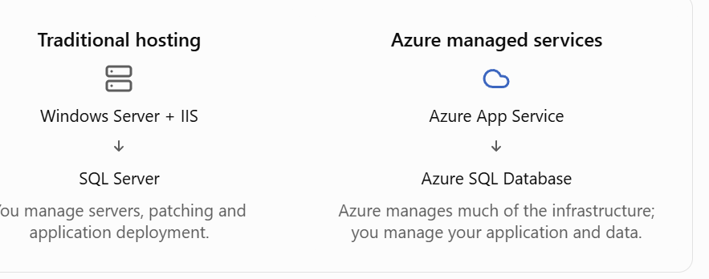
DAY 1 / FROM .NET TO AZURE
CONCEPT
You know .NET. Where would you host it?
Managed services reduce server administration; you still manage application, data, access and cost.
LBS | Azure developer training | V3 | Fictional data only
INTRO 1

Slide 5
DAY 1 / FROM .NET TO AZURE
CONCEPT
Azure names | connect them to familiar ideas
Organisation and resources
Location and access
Tenant: your identity directory.
Subscription: billing and management boundary.
Resource group (RG): groups related resources.
Resource: an actual database, app or service.
Region: geographic hosting area.
Zone: separate datacentre group in a region.
Portal: website for managing Azure.
RBAC: who can do what, at which scope.
LBS | Azure developer training | V3 | Fictional data only
INTRO 2

Slide 6
DAY 1 / FROM .NET TO AZURE
CONCEPT
One fictional mortgage application | which service?
Run the application and its work
Protect, observe and control it
.NET API -> App Service.
Application records -> Azure SQL.
PDF documents -> Blob Storage.
Small event-driven code -> Functions.
Queued background work -> Service Bus.
Secrets, keys, certificates -> Key Vault.
Password-free app identity -> Managed Identity.
Requests and failures -> Application Insights.
Analyse monitoring data -> Logs / KQL.
Understand spending -> Cost Management.
LBS | Azure developer training | V3 | Fictional data only
INTRO 3

Slide 7
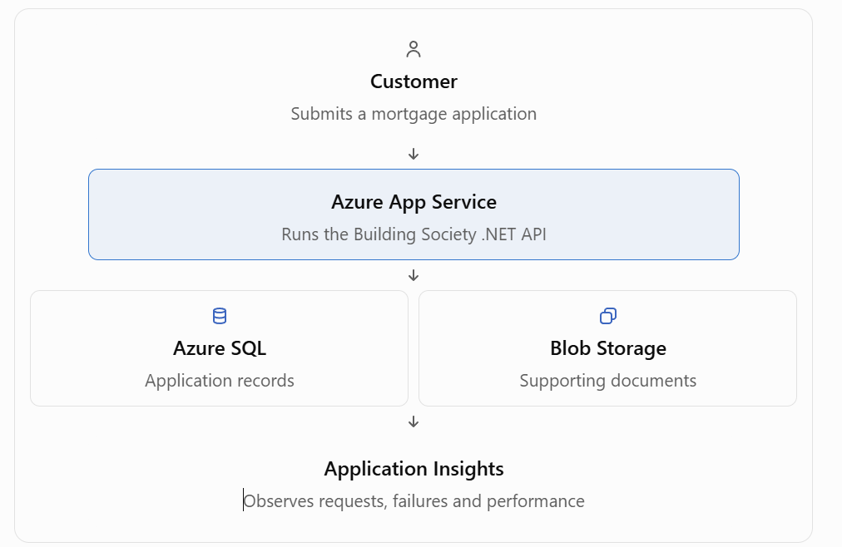
DAY 1 / FROM .NET TO AZURE
CONCEPT
A customer's request | the services work together
Fictional example. Monitoring runs alongside the app, not as the next request step. Labs test components separately.
LBS | Azure developer training | V3 | Fictional data only
INTRO 4

Slide 8
DAY 1 / FROM .NET TO AZURE
CONCEPT
Your turn | choose the service
Think in pairs | 5 minutes
Discuss together | 5 minutes
1. Where would you run a .NET API?
2. Where would you store application records?
3. Where would you store an uploaded PDF?
4. Access storage without an app password?
5. Investigate a failed API request?
6. Check how much Azure is costing?
Explain why, not just the service name.
LBS | Azure developer training | V3 | Fictional data only
INTRO 5

Slide 9
DAY 1 / SAFETY
CONCEPT
Before any write, check the target
Confirm every time
Never use a shortcut
• Tenant, subscription and resource name
• Assigned table / container / Function host
• Your identity, network path and permission
• No broad firewall rules to fix a login failure.
• No shared admin passwords or keys in evidence.
• No class-wide concurrent publish to one app.
REFERENCE / Instructor checklist and component checkpoints
Student route
LBS | Azure developer training | V3 | Fictional data only
09

Slide 10
DAY 1 / FOUNDATIONS
CONCEPT
Azure names: where does each thing belong?
Management hierarchy
Developer perspective
• Tenant: identity directory.
• Subscription: resource and billing boundary.
• Resource group: lifecycle grouping.
• Resource: server, account, app or workspace.
• Code runs on your laptop OR a cloud host.
• A SQL server is not your local SQL Express.
• A workspace name is not its Workspace ID.
• Seeing Overview does not prove data access.
LBS | Azure developer training | V3 | Fictional data only
10

Slide 11
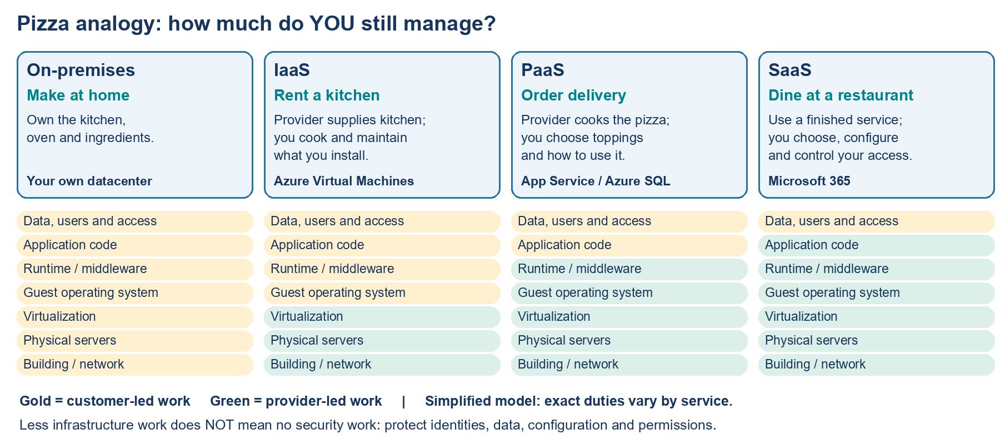
DAY 1 / FOUNDATIONS / VISUAL EXPLANATION
IaaS, PaaS and SaaS | the pizza comparison
LBS | Azure developer training | 28 Oct 2026 | Simplified teaching diagram
11

Slide 12
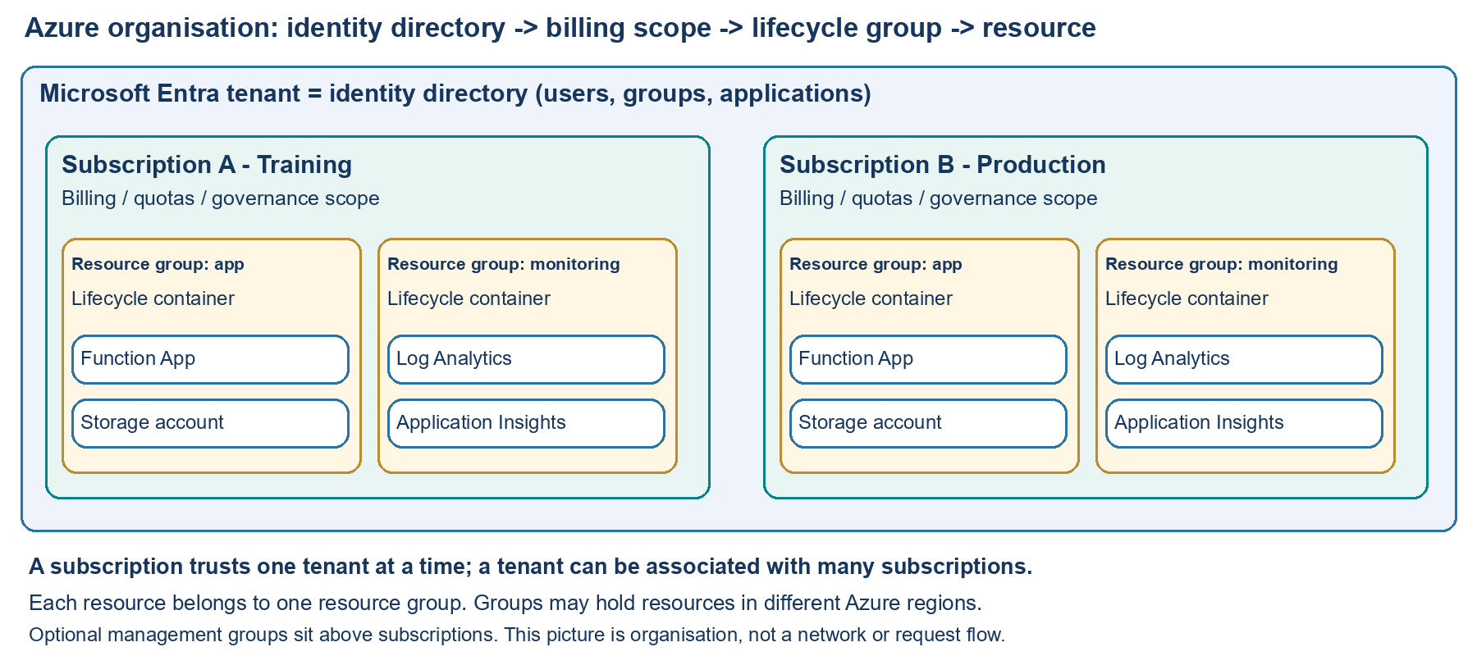
DAY 1 / FOUNDATIONS / VISUAL EXPLANATION
Tenant, subscription, resource group and resource
LBS | Azure developer training | 28 Oct 2026 | Simplified teaching diagram
12

Slide 13
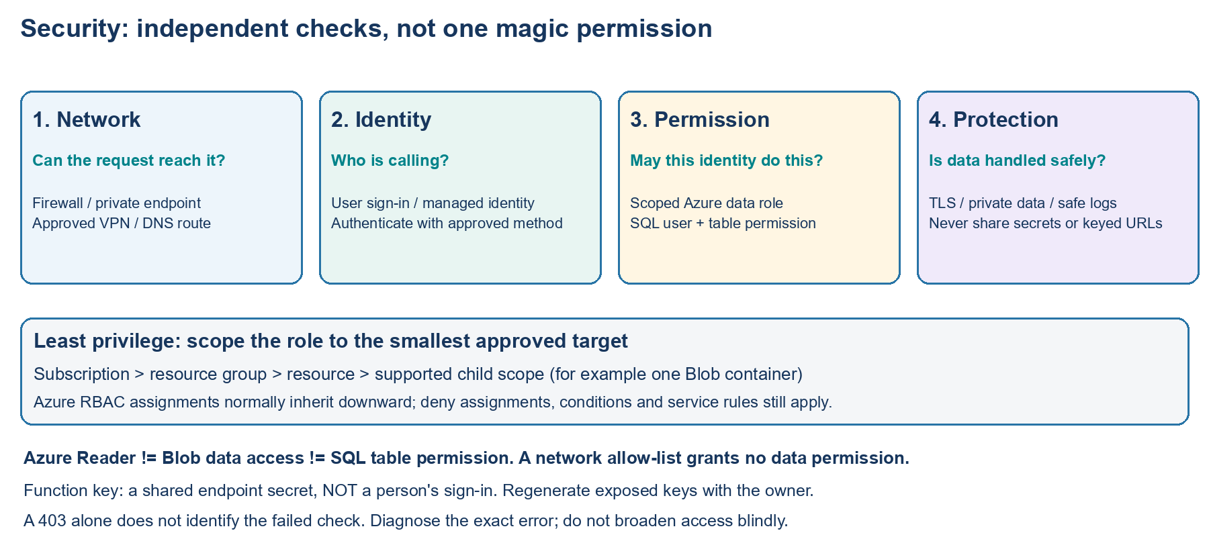
DAY 1 / FOUNDATIONS / VISUAL EXPLANATION
Security | check the network, identity and permissions
LBS | Azure developer training | 28 Oct 2026 | Simplified teaching diagram
13

Slide 14
DAY 1 / ACCESS
CONCEPT
Two gates: network reachability + permission
Network gate
Identity / data gate
• SQL: approved single-IP or private-network path.
• Blob: account firewall / private endpoint policy.
• A TCP connection alone is not a successful SELECT.
• Azure Reader does not grant SQL table access.
• Blob needs a scoped data role.
• Portal, CLI and MSSQL sign-in are separate.
REFERENCE / SQL 2A; Blob 1A-1B
SQL handout
Blob handout
LBS | Azure developer training | V3 | Fictional data only
14

Slide 15
DAY 1 / ORIENTATION
DEMO
Demo 01 | one resource, two views
Portal
VS Code
• Sign in; confirm directory and subscription.
• Open Training; identify SQL, Storage and Function.
• Record resource name and region; change nothing.
• Open the supplied lab folder; check Get-Location.
• Azure Resources: sign in, select subscription, Refresh.
• A new window may keep your old chat in the original window.
REFERENCE / Function guide Parts 1-2; orientation-only prerequisites
Function handout
Student route
LBS | Azure developer training | V3 | Fictional data only
15

Slide 16
DAY 1 / ORIENTATION
EXERCISE
Exercise 01 | prove your context
Attendee steps | 10 min
Checkpoint
• Find your assigned subscription and resource group.
• Identify one resource in both tools.
• Open the correct lab folder; check Get-Location.
• Record resource name and region.
• Record account / directory without secrets.
• Missing access? Mark Blocked; do not create a replacement.
REFERENCE / Start Here checkpoints; Function Part 2
Student route
Function handout
LBS | Azure developer training | V3 | Fictional data only
16

Slide 17
DAY 1 / SQL
CONCEPT
Azure SQL: structure is not application code
What we change
What we do not deploy
• CREATE TABLE defines the structure.
• INSERT adds fictional rows.
• ALTER TABLE adds a column.
• UPDATE changes a targeted row.
• No new database is needed.
• No Web App / API integration today.
• Saving a .sql file does not execute it.
• MSSQL and portal are clients of one database.
REFERENCE / Main exercise and sections 6-7
SQL handout
LBS | Azure developer training | V3 | Fictional data only
17

Slide 18
DAY 1 / COST-AWARE LAB PRACTICE
Azure SQL | avoid paying for unnecessary capacity
What drives cost?
Student cost-saving habits
• Compute tier, allocated capacity and storage.
• Backup retention and optional replicas can add cost.
• Eligible serverless auto-pause stops compute billing while paused; storage still costs.
• Use the assigned database; do not create a duplicate.
• Use tiny tables and targeted queries.
• Do not change tiers or auto-pause on shared databases.
• Ask the owner about approved temporary-data cleanup.
Use approved existing resources. Ask before changing tiers, retention, capacity or shared settings.
Official service pricing / guidance (check current region and offer)
LBS | Attendee edition | Cost tips are guidance, not a quotation or spending cap.
18

Slide 19
DAY 1 / SQL ACCESS
DEMO
Demo 02 | add an approved client IP
Portal | authorised operator
Explain before testing
• Database -> Server link -> Security > Networking.
• With approval, choose Selected networks.
• Add current public IPv4; Start = End.
• Save, reopen and verify the exact rule.
• Do not copy a screenshot's old IP.
• Private laptop IP is not public outbound IP.
• Leave Allow Azure services unchecked.
• Wait up to five minutes, then reconnect.
Instructor permission required; a firewall rule does not create a database user.
REFERENCE / Section 2A A-E: complete firewall walkthrough
SQL handout
LBS | Azure developer training | V3 | Fictional data only
19

Slide 20
DAY 1 / SQL
DEMO
Demo 03 | create in portal, read in VS Code
Portal
VS Code / MSSQL
• Connect to the assigned database, not master.
• Run the connection check; verify DB_NAME().
• Run 02-create-and-read.sql with your suffix.
• Expect exactly two fictional rows.
• Create the approved server/database profile.
• Encrypt enabled; Trust server certificate=False.
• Open a SQL file; connect it; Execute Query.
• SELECT the same rows and compare.
REFERENCE / Sections 3-6; instructor SELECT is read-only
SQL handout
Read-only instructor SELECT
LBS | Azure developer training | V3 | Fictional data only
20

Slide 21
DAY 1 / SQL
EXERCISE
Exercise 02 | modify and verify both ways
Do | 20 min
Expected evidence
• Use only your assigned table suffix.
• Run 03-modify-and-check.sql in MSSQL.
• Keep GO between ALTER and later statements.
• Rerun the SELECT in portal Query editor.
• Four columns, including nullable Notes.
• ID 1: Completed / Updated from VS Code.
• ID 2: Needs review / NULL.
• Optional: change ID 2 Notes in portal; read in MSSQL.
No WHERE, no targeted update: pause and inspect before execution.
REFERENCE / Section 7 and completion checklist
SQL handout
LBS | Azure developer training | V3 | Fictional data only
21

Slide 22
DAY 1 / TROUBLESHOOTING
CONCEPT
SQL: classify the error before changing anything
Connectivity / startup
Authentication / execution
• Wrong hostname: copy from server Overview.
• Timeout: verify approved route and current IP.
• Paused serverless database: allow resume and retry.
• Blank portal blade: a portal-loading issue, not proof of SQL denial.
• Login failed: identity, tenant and database.
• Permission denied: scoped SQL rights.
• Wrong result: database, suffix and selected SQL text.
• Invalid Notes column: retain the GO batch boundary.
REFERENCE / Section 9 troubleshooting
SQL handout
LBS | Azure developer training | V3 | Fictional data only
22

Slide 23
DAY 1 / STORAGE
CONCEPT
Blob Storage: private files, not a public website
Resource model
This exercise
• Account -> container -> blob.
• A private container blocks anonymous reads.
• Network rules and Entra data roles are separate.
• Tiny fictional .txt files only.
• Storage Blob Data Contributor at assigned container.
• CLI always uses --auth-mode login.
• No keys, SAS or Function bindings.
REFERENCE / Sections 1, 1A and 1B
Blob handout
LBS | Azure developer training | V3 | Fictional data only
23

Slide 24
DAY 1 / COST-AWARE LAB PRACTICE
Blob Storage | tiny files, appropriate access tiers
What drives cost?
Student cost-saving habits
• Stored bytes, operations and redundancy.
• Retrieval and data transfer can add charges.
• Cool, cold and archive may have minimum retention / early deletion charges.
• Use tiny fictional files in your assigned container.
• Hot is appropriate for this short, frequently accessed lab.
• Avoid repeated downloads and unnecessary copies.
• Delete only your lab data after owner approval.
Use approved existing resources. Ask before changing tiers, retention, capacity or shared settings.
Official service pricing / guidance (check current region and offer)
LBS | Attendee edition | Cost tips are guidance, not a quotation or spending cap.
24

Slide 25
DAY 1 / STORAGE ACCESS
DEMO
Demo 04 | prepare access without widening it
Portal checks
Explain the boundaries
• Account > Networking: all / selected / disabled?
• Selected networks: approved exact public IP only.
• IAM: verify container-scoped data role.
• Blob view: switch to Microsoft Entra user account.
• Private container != private endpoint.
• If all networks allowed, an extra IP is not needed.
• Never tighten shared account networking mid-demo.
• Wait for role propagation; do not add broader roles.
REFERENCE / Sections 1A-1B; network and IAM walkthroughs
Blob handout
LBS | Azure developer training | V3 | Fictional data only
25

Slide 26
DAY 1 / STORAGE
DEMO
Demo 05 | portal upload -> terminal download
Portal
VS Code terminal
• Open your assigned private container.
• Upload Samples\Storage\portal-note.txt.
• Leave overwrite off; Refresh after success.
• Confirm the file and nonzero byte length.
• Sign Azure CLI in separately; confirm subscription.
• Set $account and $container to assigned values.
• List and download using --auth-mode login.
• Compare source and downloaded SHA256 hashes.
REFERENCE / Sections 2-6; copy exact commands from the handout
Blob handout
LBS | Azure developer training | V3 | Fictional data only
26

Slide 27
DAY 1 / STORAGE
EXERCISE
Exercise 03 | terminal upload -> portal verify
Do | 20 min
Checkpoint
• Open and save vscode-note.txt.
• Upload to your own container; no blind overwrite.
• Check CLI exit code and list both names.
• Refresh portal; inspect/download the new file.
• Refresh the assigned container; confirm the uploaded name.
• Download; copy its real path from browser Downloads.
• Get-FileHash: compare full SHA256 with the exact source.
• Repeat for both directions; no blind overwrite or deletion.
REFERENCE / Sections 7-8; repeat-run and cleanup guidance
Blob handout
LBS | Azure developer training | V3 | Fictional data only
27

Slide 28
DAY 1 / FUNCTIONS
CONCEPT
HTTP Function: code that has a cloud host
Local concepts
Cloud concepts
• HelloAzureFunction: project folder.
• ApplicationStatus: the function name and route.
• Core Tools runs the local Functions host.
• Azurite is local development storage.
• Function App: approved deployment target.
• .NET 10 isolated runtime must match the project.
• Function-level key protects this training endpoint.
• This fixed JSON does not read SQL or Blob.
REFERENCE / Names, prerequisites and Parts 3-5
Function handout
LBS | Azure developer training | V3 | Fictional data only
28

Slide 29
DAY 1 / COST-AWARE LAB PRACTICE
Azure Functions | local testing is not Azure shutdown
What drives cost?
Student cost-saving habits
• Hosting plan, executions and execution resources.
• Always-ready instances can add baseline charges.
• Host storage, logs and network services have separate costs.
• Build and test locally first; avoid repeated cloud calls.
• Reuse the approved host; no duplicate plan.
• Ctrl+C stops only the local server, not Azure charges.
• Do not change shared scaling / always-ready settings.
Use approved existing resources. Ask before changing tiers, retention, capacity or shared settings.
Official service pricing / guidance (check current region and offer)
LBS | Attendee edition | Cost tips are guidance, not a quotation or spending cap.
29

Slide 30
DAY 1 / FUNCTIONS
DEMO
Demo 06 | build, host, then request
Terminal 1
Terminal 2
• Open HelloAzureFunction by itself.
• Create local settings from supplied example if absent.
• Build; start Azurite.
• func start --port 7071; KEEP IT RUNNING.
• Request /api/ApplicationStatus on localhost:7071.
• Check reference, Received, fictionalData and message.
• After testing: Ctrl+C in terminal 1; wait for prompt.
• Local host stops; Azure host and source code remain.
Build alone is not an HTTP test. Verify your own local response; Ctrl+C stops only your local host.
REFERENCE / Part 3: local settings, host and second-terminal test
Function handout
LBS | Azure developer training | V3 | Fictional data only
30

Slide 31
DAY 1 / FUNCTIONS
DEMO
Demo 07 | publish only to an approved host
VS Code publishing route
Cloud verification
• Confirm target name, runtime and replacement approval.
• Use the supplied Function project and publish task.
• Choose the assigned Function App, not a Web App.
• Wait for success, then verify the deployed function.
• Get Function URL: choose default (Function key).
• Not Host key or _master; paste into browser, not chat.
• Keyed: expected JSON; Test/Run can show HTTP 200.
• Remove ?code=...: expect HTTP 401, not a broken app.
REFERENCE / Parts 4-5; test-only route if publish not approved
Function handout
LBS | Azure developer training | V3 | Fictional data only
31

Slide 32
DAY 1 / FUNCTIONS
EXERCISE
Exercise 04 | record local and cloud separately
Do | 20 min
Checkpoint
• Run the supplied local Function when tools are ready.
• Publish only with target-owner approval.
• Otherwise test the approved existing cloud endpoint.
• Record status code and response fields, never keys.
• Local host: Passed / Blocked / Not run.
• Publish: Passed / Not approved / Not run.
• Cloud: expected response and keyless denial.
• Website results are Not run in Function-only route.
REFERENCE / Parts 3-5 and Function-related Part 8 results
Function handout
LBS | Azure developer training | V3 | Fictional data only
32

Slide 33
DAY 1 / OBSERVABILITY
CONCEPT
Log Analytics is the service; KQL is the language
Workspace
KQL
• Holds queryable log tables.
• Has a name, resource ID and Workspace ID GUID.
• Query access is separate from Overview access.
• Pipe operators transform tabular results.
• where filters; project selects columns.
• order by sorts; summarize aggregates.
• A saved .kql file is not an ingested log.
REFERENCE / Sections 1-3
Logs / KQL handout
LBS | Azure developer training | V3 | Fictional data only
33

Slide 34
DAY 1 / COST-AWARE LAB PRACTICE
Log Analytics | collect what you actually need
What drives cost?
Student cost-saving habits
• Log ingestion and retention beyond included allowances.
• Some table plans charge for queries / search.
• Export, alerts and other monitoring features may add cost.
• Use the supplied synthetic query; it ingests no rows.
• For real logs, use a short time range and relevant scope.
• Do not enable verbose logging or new collection just for practice.
• Ask the owner before changing retention or caps.
Use approved existing resources. Ask before changing tiers, retention, capacity or shared settings.
Official service pricing / guidance (check current region and offer)
LBS | Attendee edition | Cost tips are guidance, not a quotation or spending cap.
34

Slide 35
DAY 1 / KQL
DEMO
Demo 08 | start with a predictable query
Portal Logs
Explain the result
• Open assigned workspace; confirm query scope.
• Close Welcome and Queries hub (top-right X).
• Turn Agent off; select KQL mode above the editor.
• Paste supplied query; Run; expect three ordered rows.
• LBS-DEMO-1001: Completed.
• LBS-DEMO-1002: Needs review.
• LBS-DEMO-1003: Received.
• Rows are synthetic; no ingestion is proven.
REFERENCE / Sections 2-3; no ADX cluster required
Logs / KQL handout
Supplied KQL
LBS | Azure developer training | V3 | Fictional data only
35

Slide 36
DAY 1 / KQL
CONCEPT
Read the pipeline from top to bottom
Supplied main query
Try only in a separate portal tab
datatable(Reference:string, Status:string)
[
"LBS-DEMO-1001", "Completed",
"LBS-DEMO-1002", "Needs review",
"LBS-DEMO-1003", "Received"
]
| order by Reference asc
• Add a where filter for Completed: one row.
• Restore the original before terminal comparison.
• Keep supplied KQL and request JSON in sync.
• The main script asserts exactly three rows.
REFERENCE / Section 3; optional filter practice
Logs / KQL handout
Supplied KQL
LBS | Azure developer training | V3 | Fictional data only
36

Slide 37
DAY 1 / KQL
EXERCISE
Exercise 05 | same query from VS Code
Do | 15 min
Checkpoint
• Workspace Overview > Essentials > copy Workspace ID.
• Not workspace name, Subscription ID or resource ID.
• In PortalAndVsCodeBasics, use the signed-in CLI.
• Run the supplied script with that GUID; compare results.
• Script prints three expected rows and PASS.
• Compare with portal Logs results.
• Record workspace and result time.
• No workspace key, agent or new table needed.
REFERENCE / Sections 4-5; exact script invocation
Logs / KQL handout
LBS | Azure developer training | V3 | Fictional data only
37

Slide 38
DAY 1 / PRACTICE
EXERCISE
Optional | dummy tracker UI is not integration
Local-only UI practice
Say this explicitly
• Open DummyDocumentTracker.
• Run on localhost:5203 using the guide.
• Check three records and detail buttons.
• Fixed sample records, not SQL rows.
• No upload/processing or Blob integration.
• The real local scenario is a different project.
• No website deployment required today.
REFERENCE / Parts 6-8 only; optional local UI
Function handout
LBS | Azure developer training | V3 | Fictional data only
38

Slide 39
DAY 1 / COST-AWARE LAB PRACTICE
App Service / local websites | understand the hosting boundary
What drives cost?
Student cost-saving habits
• Paid App Service plans charge for allocated instances.
• Stopping an app does not stop paid plan charges.
• Related storage, monitoring and network services can still cost.
• Run the optional dummy UI locally; Azure hosting is not required.
• Never create a paid Web App without approval.
• The Function FC1 plan is not the website's hosting target.
• Only the owner approves plan deletion or resizing.
Use approved existing resources. Ask before changing tiers, retention, capacity or shared settings.
Official service pricing / guidance (check current region and offer)
LBS | Attendee edition | Cost tips are guidance, not a quotation or spending cap.
39

Slide 40
DAY 1 / TROUBLESHOOTING
CONCEPT
A repeatable troubleshooting ladder
Check in order
Then verify
• 1. Correct folder, file and tool?
• 2. Correct tenant, subscription and target?
• 3. Reachable network and current IP?
• 4. Correct identity and scoped permission?
• 5. Exact error / CLI exit code?
• 6. Small read-only request first.
• 7. Make one approved change; retest.
• 8. Save evidence without sensitive data.
REFERENCE / Check each service's troubleshooting section
Student route
LBS | Azure developer training | V3 | Fictional data only
40

Slide 41
DAY 1 / RECAP
EXERCISE
Day 1 exit ticket
Explain
Demonstrate
• Why are network and identity separate gates?
• What executes when you save a SQL/KQL file?
• How is a private container different from a private endpoint?
• Show one verified component in both tools.
• Record a blocked step accurately.
• Identify the correct guide and safe cleanup.
• Tomorrow: messaging, real telemetry and the whole workflow.
REFERENCE / Component checkpoints; retain your results
Student route
LBS | Azure developer training | V3 | Fictional data only
41

Slide 42
DAY 1 / REFERENCES
CONCEPT
Your Day 1 documents
Use the handouts for exact steps
Continue independently
• Start Here: order and checkpoints.
• SQL: firewall, MSSQL and modification scripts.
• Blob: network/IAM and two-way file checks.
• Function: local / approved publish / cloud checks.
• Logs/KQL: workspace and matching synthetic query.
• Illustrated Day 1 quick reference: diagrams + checklist.
• Record your own Passed / Blocked / Not run results.
REFERENCE / Clickable links below; keep deck beside documents
Student route
SQL handout
Blob handout
Function handout
Logs / KQL handout
LBS | Azure developer training | V3 | Fictional data only
42

